Slide 1
Myerson’s Lemma
Prepared and Presented by
Zeng Yuxiang

Slide 2
The Story So Far

Slide 3
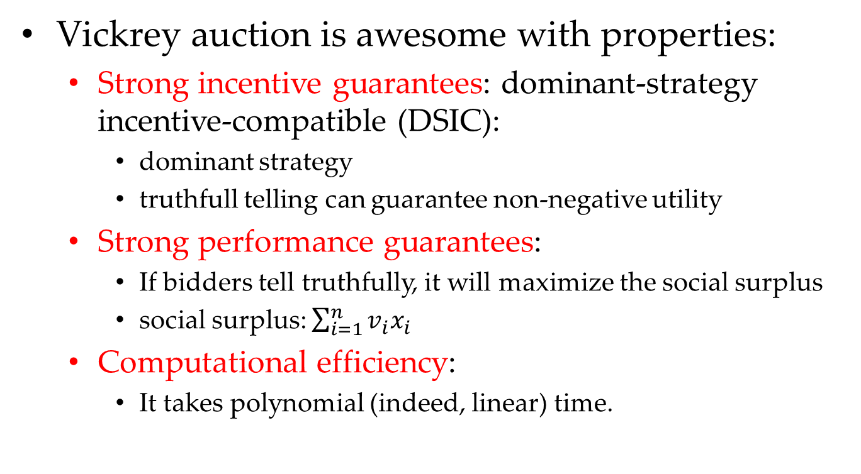
Awesome Auction
Vickrey auction is awesome with properties:
Strong incentive guarantees: dominant-strategy incentive-compatible (DSIC):
dominant strategy
truthfull telling can guarantee non-negative utility
Strong performance guarantees:
If bidders tell truthfully, it will maximize the social surplus
social surplus: $\sum_{i=1}^{n}{v_{i}x_{i}}$
Computational efficiency:
It takes polynomial (indeed, linear) time.

Slide 4
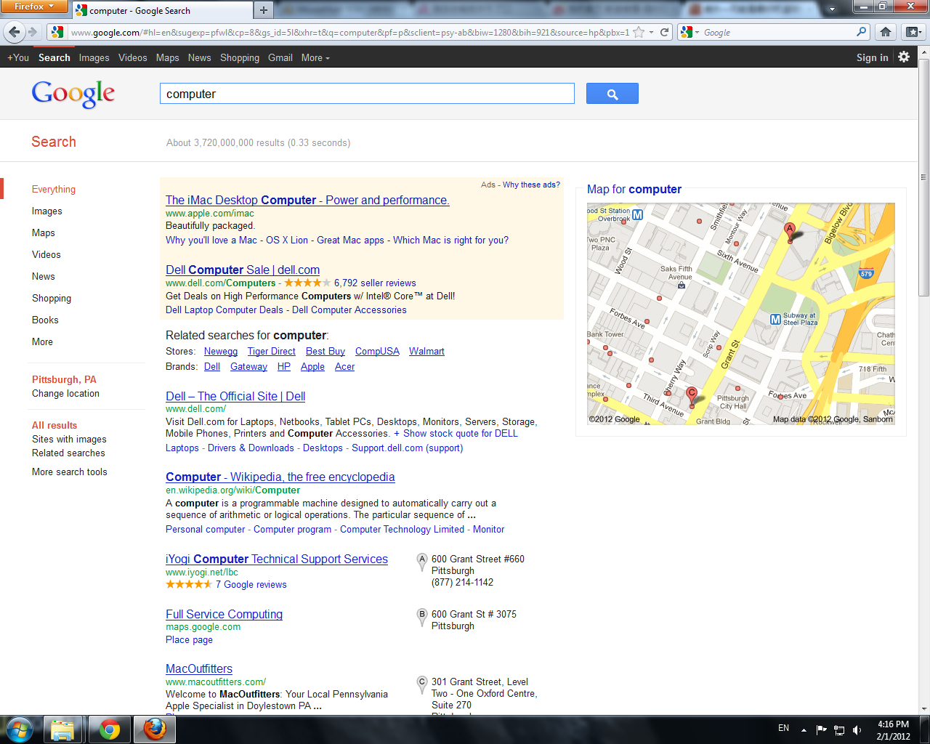
Sponsored Search Auctions: Background

Slide 5
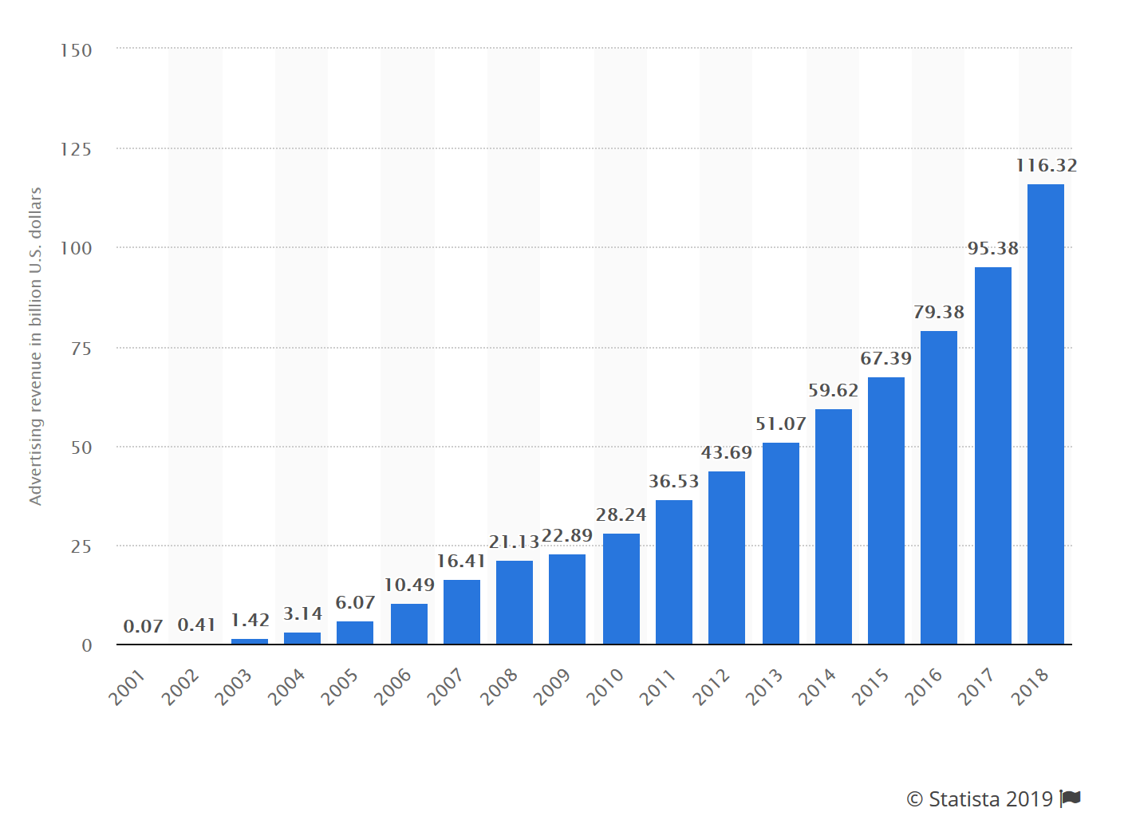
Sponsored Search Auctions: Background
2001~2018年谷歌广告的收入（单位：十亿美元）
In 2006, 98% of Google’s revenue comes from sponsored search.

Slide 6
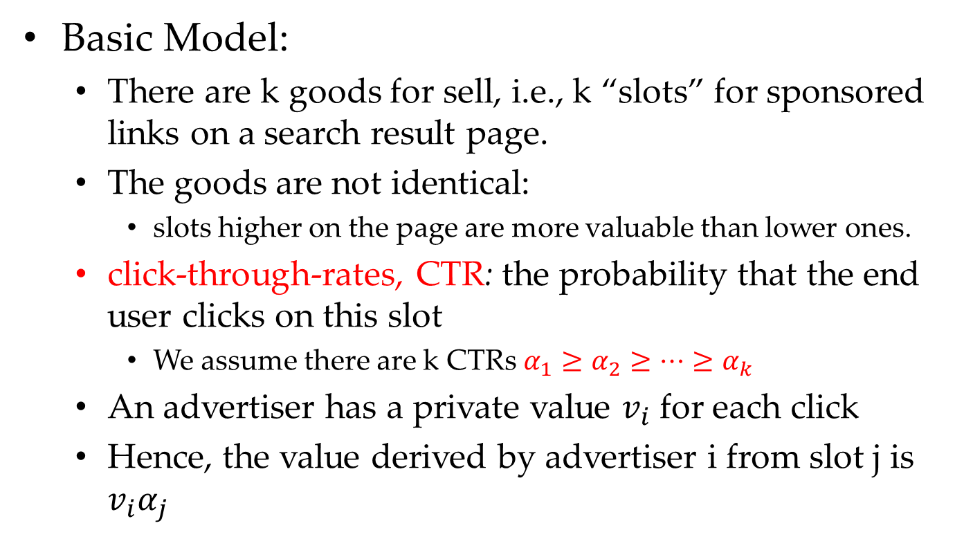
Sponsored Search Auctions: Background
Basic Model:
There are k goods for sell, i.e., k “slots” for sponsored links on a search result page.
The goods are not identical:
slots higher on the page are more valuable than lower ones.
click-through-rates, CTR: the probability that the end user clicks on this slot
We assume there are k CTRs $α_{1}≥α_{2}≥⋯≥α_{k}$
An advertiser has a private value $v_{i}$ for each click
Hence, the value derived by advertiser i from slot j is $v_{i}α_{j}$

Slide 7
Sponsored Search Auctions: What We Want
DSIC: truthful telling is a dominant strategy, and leads to non-negative utility.
Social-surplus Maximization: the mechanism would maximize the outcome of auctioneer.
Computational Efficiency: the mechanism should be terminated in polynomial time.

Slide 8
Sponsored Search Auctions: Our Design Approach
Challenge:
the choice of who wins what
the choice of who pays what
Basic Idea:
Step 1: Assume bidders are truthful, how to assign bidders to slots such that property (2) and (3) hold?
Step 2: Given answer in Step 1, how should we set selling prices such that property (1) holds?

Slide 9
Sponsored Search Auctions: Our Design Approach
Natural Idea of Step 1:
Greedy: Assign the j-th highest bidder to the j-th highest slot
Natural Idea of Step 2:
Second-Price Auction: will be elaborated in the next lecture, Myerson’s Lemma

Slide 10
Mechanism Design Environment

Slide 11
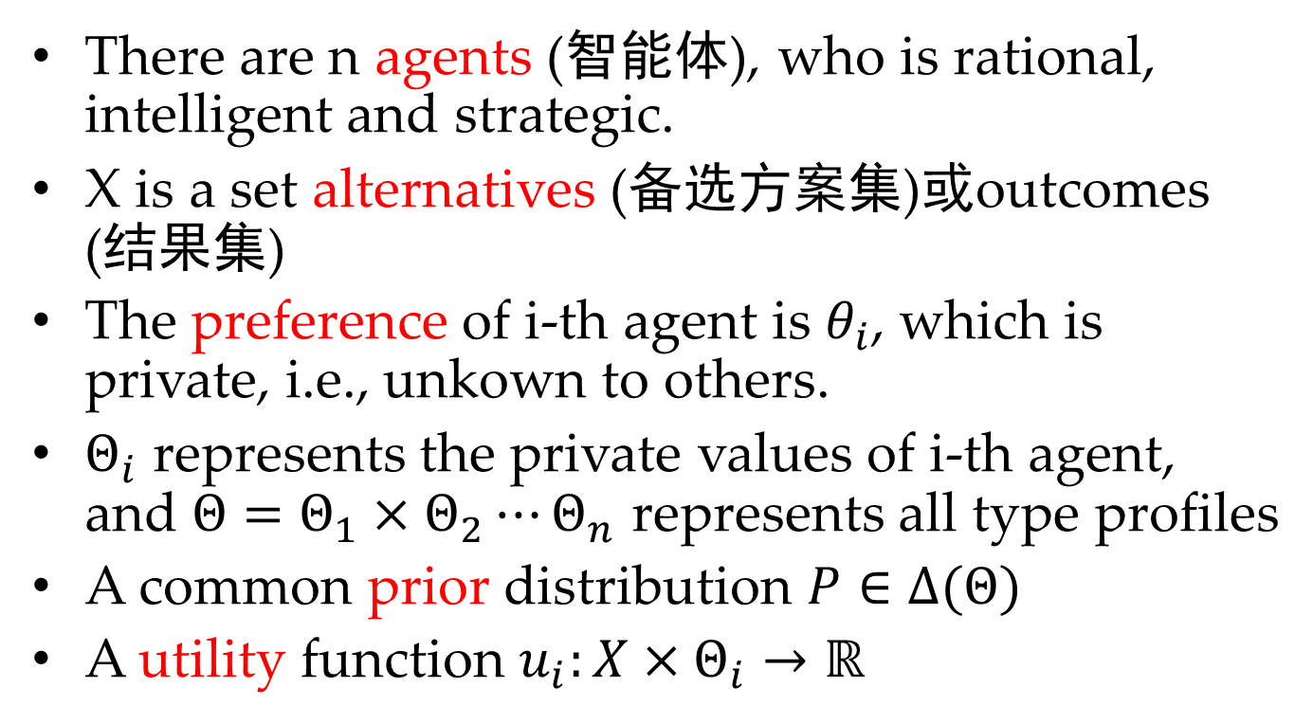
Mechanism Design Environment: General Setting
There are n agents (智能体), who is rational, intelligent and strategic.
X is a set alternatives (备选方案集)或outcomes (结果集)
The preference of i-th agent is $θ_{i}$, which is private, i.e., unkown to others.
$Θ_{i}$ represents the private values of i-th agent, and $Θ=Θ_{1}×Θ_{2}⋯Θ_{n}$ represents all type profiles
A common prior distribution $P∈∆(Θ)$
A utility function $u_{i}:X×Θ_{i}→ℝ$

Slide 12
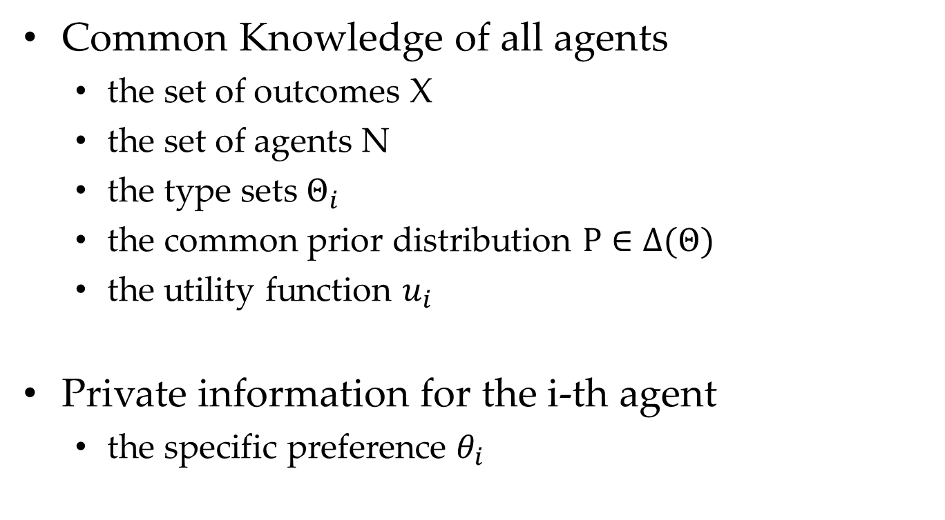
Mechanism Design Environment: General Setting
Common Knowledge of all agents
the set of outcomes X
the set of agents N
the type sets $Θ_{i}$
the common prior distribution $P∈∆(Θ)$
the utility function $u_{i}$
Private information for the i-th agent
the specific preference $θ_{i}$

Slide 13
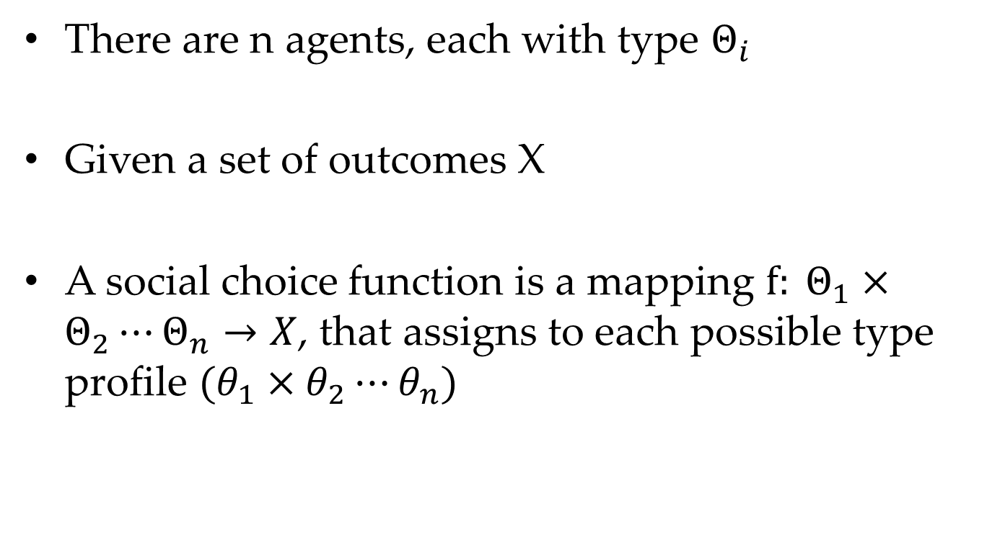
Mechanism Design Environment: Social Choice Function
There are n agents, each with type $Θ_{i}$
Given a set of outcomes X
A social choice function is a mapping $f: Θ_{1}×Θ_{2}⋯Θ_{n}→X$, that assigns to each possible type profile $(θ_{1}×θ_{2}⋯θ_{n})$

Slide 14
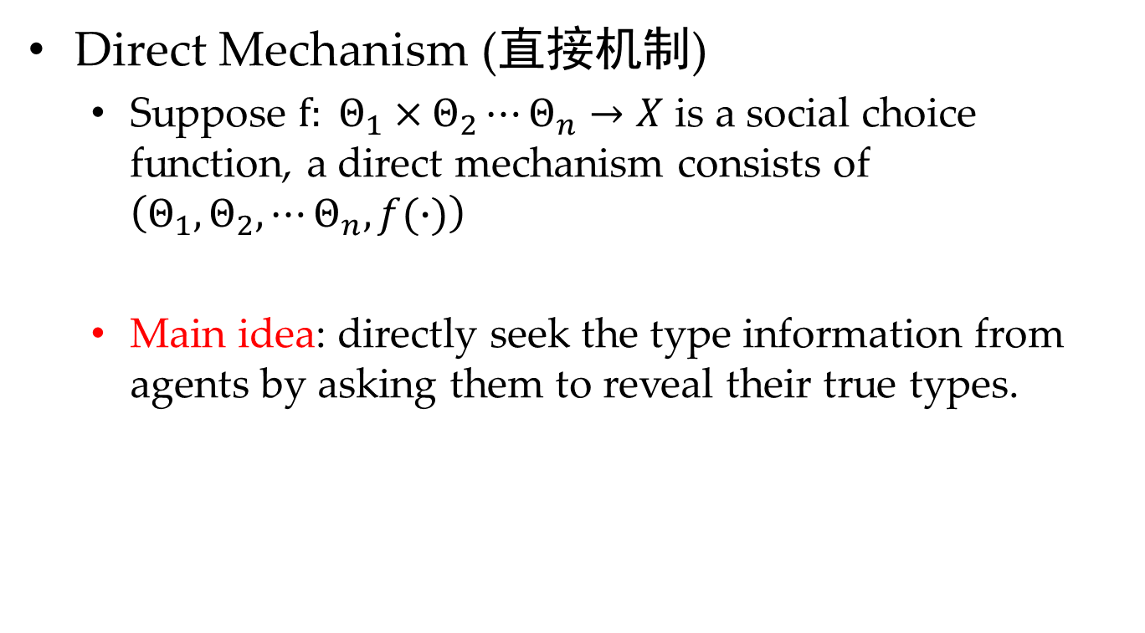
Mechanism Design Environment: Direct Mechanism
Direct Mechanism (直接机制)
Suppose $f: Θ_{1}×Θ_{2}⋯Θ_{n}→X$ is a social choice function, a direct mechanism consists of $\left(Θ_{1},Θ_{2},⋯Θ_{n},f(∙)\right)$
Main idea: directly seek the type information from agents by asking them to reveal their true types.

Slide 15
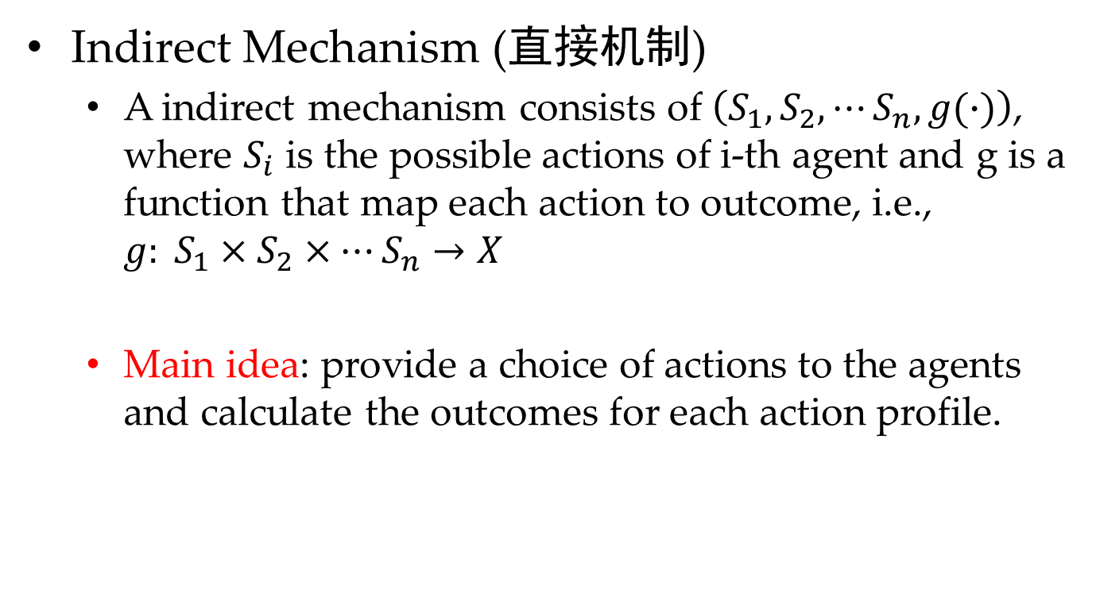
Mechanism Design Environment: Indirect Mechanism
Indirect Mechanism (直接机制)
A indirect mechanism consists of $\left(S_{1},S_{2},⋯S_{n},g(∙)\right)$, where $S_{i}$ is the possible actions of i-th agent and g is a function that map each action to outcome, i.e., $g: S_{1}×S_{2}×⋯S_{n}→X$
Main idea: provide a choice of actions to the agents and calculate the outcomes for each action profile.
Direct Mechanism and Indirect Mechanism,
which one is more general ???

Slide 16
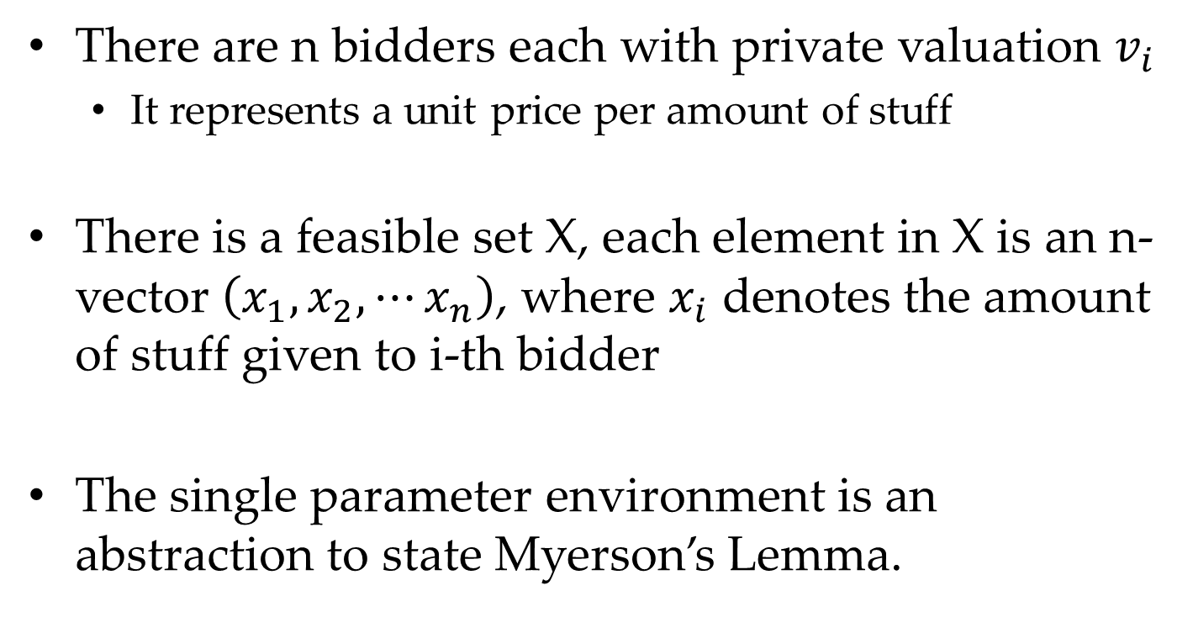
Mechanism Design Environment: Single-Parameter Environment
There are n bidders each with private valuation $v_{i}$
It represents a unit price per amount of stuff
There is a feasible set X, each element in X is an n-vector $\left(x_{1},x_{2},⋯x_{n}\right)$, where $x_{i}$ denotes the amount of stuff given to i-th bidder
The single parameter environment is an abstraction to state Myerson’s Lemma.

Slide 17
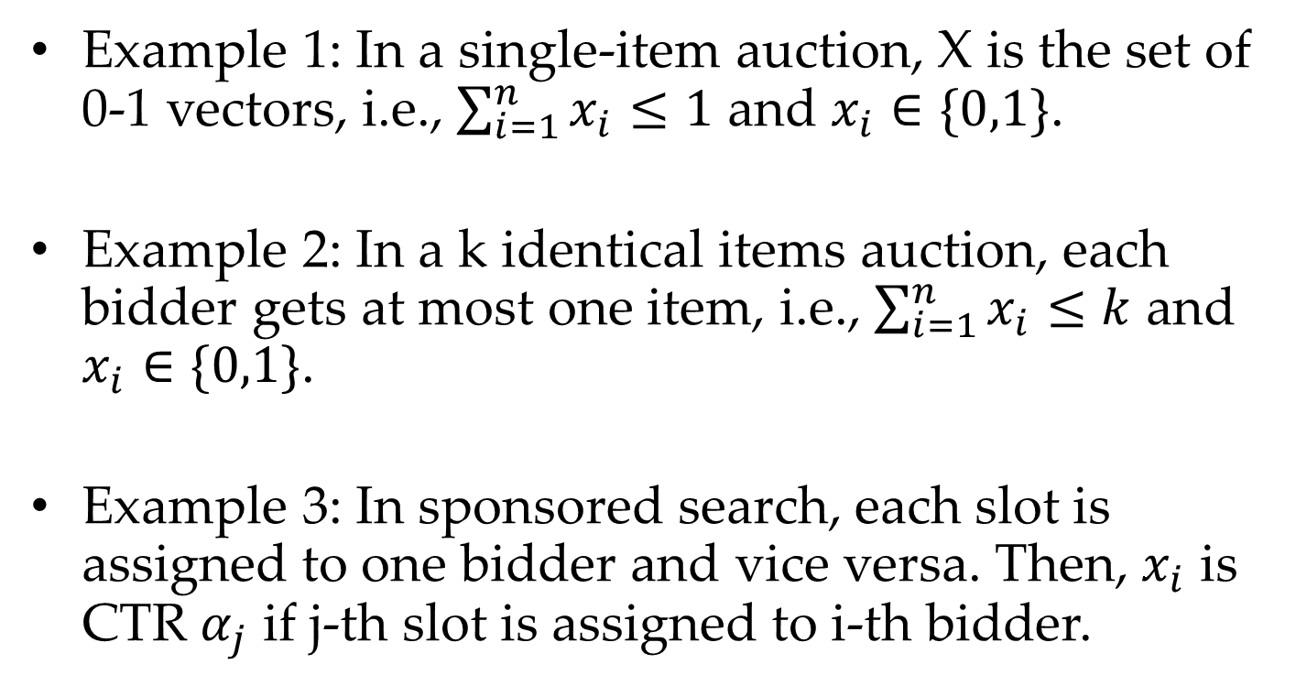
Mechanism Design Environment: Single-Parameter Environment
Example 1: In a single-item auction, X is the set of 0-1 vectors, i.e., $\sum_{i=1}^{n}{x_{i}}≤1$ and $x_{i}∈\{0,1\}$.
Example 2: In a k identical items auction, each bidder gets at most one item, i.e., $\sum_{i=1}^{n}{x_{i}}≤k$ and $x_{i}∈\{0,1\}$.
Example 3: In sponsored search, each slot is assigned to one bidder and vice versa. Then, $x_{i}$ is CTR $α_{j}$ if j-th slot is assigned to i-th bidder.

Slide 18
Allocation and Payment Rules

Slide 19
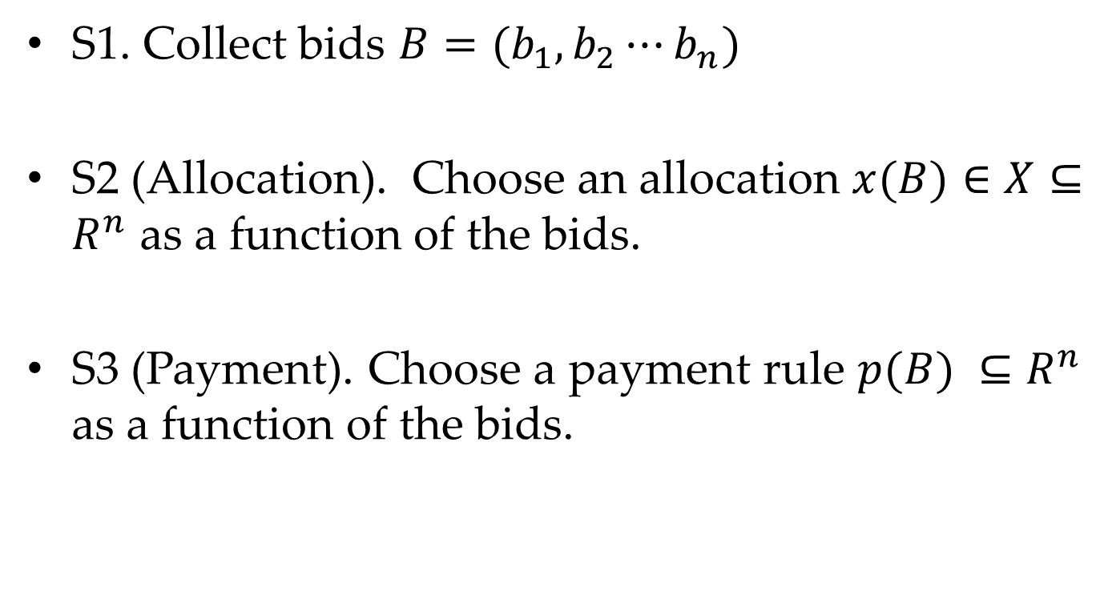
Solution: Main Steps
S1. Collect bids $B=(b_{1},b_{2}⋯b_{n})$
S2 (Allocation). Choose an allocation $x(B)∈X⊆R^{n}$ as a function of the bids.
S3 (Payment). Choose a payment rule $p(B) ⊆R^{n}$ as a function of the bids.

Slide 20
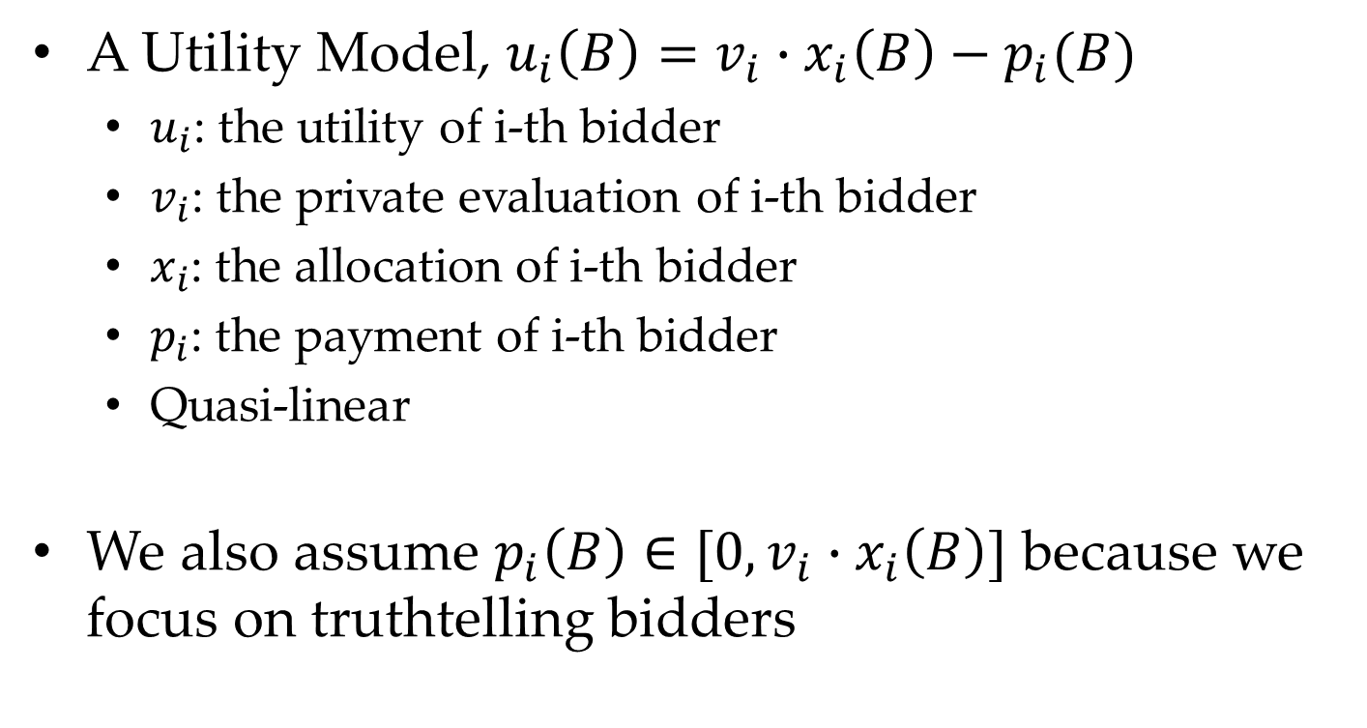
Solution: Assumptions
A Utility Model, $u_{i}\left(B\right)=v_{i}∙x_{i}\left(B\right)−p_{i}(B)$
$u_{i}$: the utility of i-th bidder
$v_{i}$: the private evaluation of i-th bidder
$x_{i}$: the allocation of i-th bidder
$p_{i}$: the payment of i-th bidder
Quasi-linear
We also assume $p_{i}\left(B\right)∈[0,v_{i}∙x_{i}\left(B\right)]$ because we focus on truthtelling bidders

Slide 21
Statement of Myerson’s Lemma

Slide 22
Implementable Allocation Rule
Statement 1: Implementable Allocation Rule
An allocation rule x for a single-parameter environment is implementable if there is a payment rule p such the sealed-bid auction (x, p) is DSIC.
Meaning:
A DSIC mechanism indicates a implementable allocation.
Is the Greedy-based allocation rule
for sponsored search implementable?

Slide 23
Implementable Allocation Rule
Statement 1: Implementable Allocation Rule
An allocation rule x for a single-parameter environment is implementable if there is a payment rule p such the sealed-bid auction (x, p) is DSIC.
Example:
Is the allocation rule that awards the good to the highest bidder implementable?
YES: The second-price rule guarantees DSIC.
Is the allocation rule that awards the good to the second-highest bidder implementable?
Not sure.

Slide 24
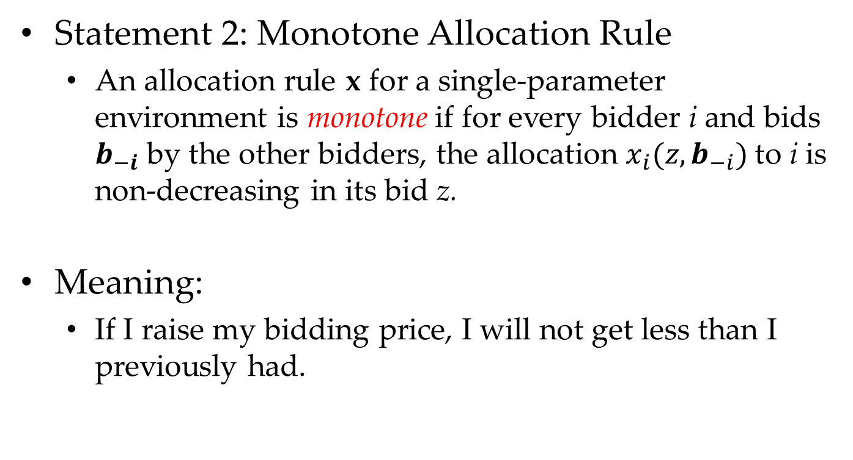
Monotone Allocation Rule
Statement 2: Monotone Allocation Rule
An allocation rule x for a single-parameter environment is monotone if for every bidder i and bids $b_{−i}$ by the other bidders, the allocation $x_{i}(z,b_{−i})$to i is non-decreasing in its bid z.
Meaning:
If I raise my bidding price, I will not get less than I previously had.

Slide 25
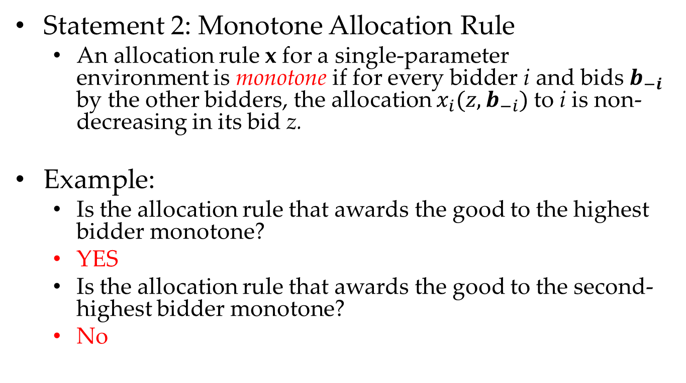
Monotone Allocation Rule
Statement 2: Monotone Allocation Rule
An allocation rule x for a single-parameter environment is monotone if for every bidder i and bids $b_{−i}$ by the other bidders, the allocation $x_{i}(z,b_{−i})$to i is non-decreasing in its bid z.
Example:
Is the allocation rule that awards the good to the highest bidder monotone?
YES
Is the allocation rule that awards the good to the second-highest bidder monotone?
No

Slide 26
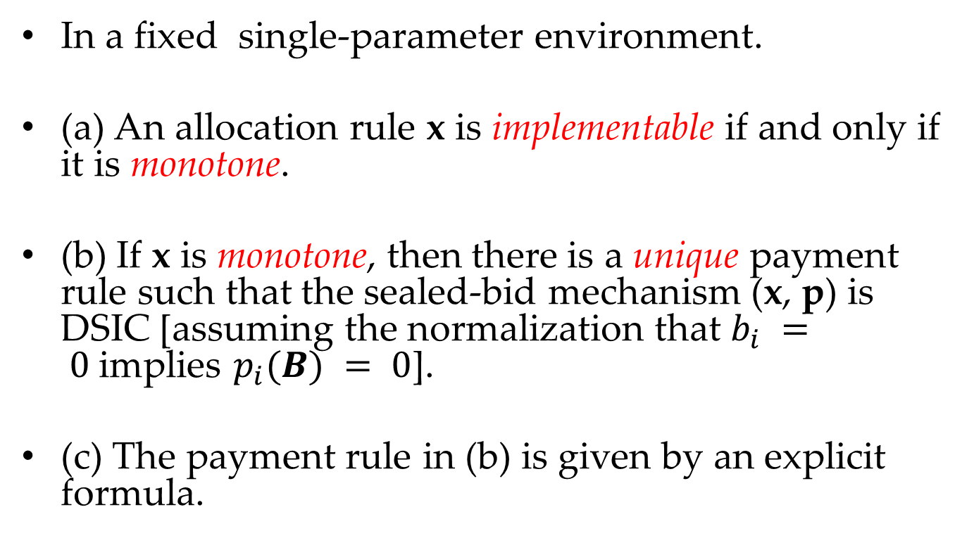
Myerson’s Lemma
In a fixed single-parameter environment.
(a) An allocation rule x is implementable if and only if it is monotone.
(b) If x is monotone, then there is a unique payment rule such that the sealed-bid mechanism (x, p) is DSIC [assuming the normalization that $b_{i} = 0$implies $p_{i}(B) = 0$].
(c) The payment rule in (b) is given by an explicit formula.

Slide 27
Myerson’s Lemma
Myerson’s Lemma (a) indicates the set of implementable allocation rules is the same set of monotone allocation rules.
Myerson’s Lemma (b) indicates when the allocation rule is monotone, there is only one payment rule to guarantee DSIC.
Myersons’ Lemma (c) gives the formula of this payment rule.

Slide 28
Proof of Myerson’s Lemma

Slide 29
Proof of Myerson’s Lemma
Step1
Prove Myerson’s Lemma (a) “only if”
Step2
Prove Myerson’s Lemma (b)
Step3
Prove Myerson’s Lemma (c)
Step4
Prove Myerson’s Lemma (a) “if”

Slide 30
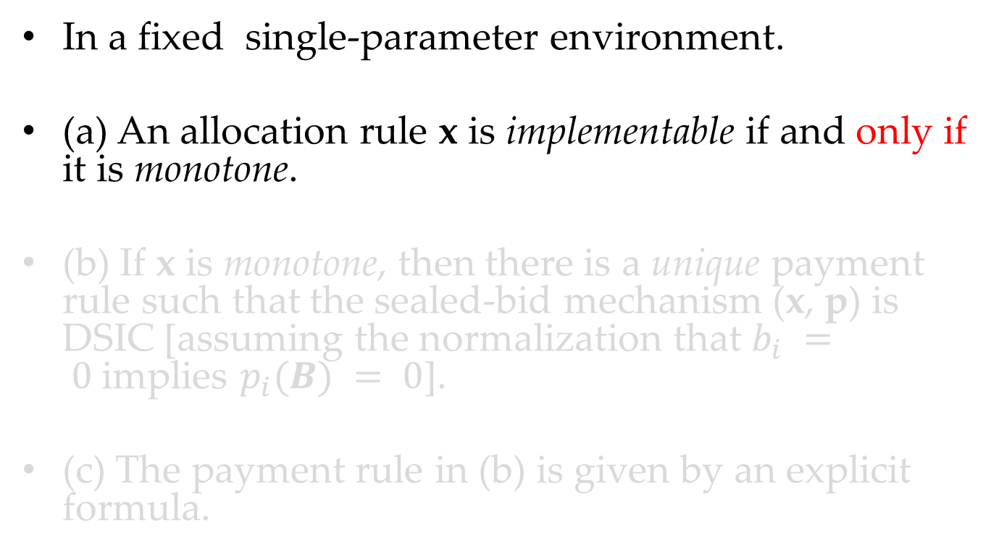
Myerson’s Lemma
In a fixed single-parameter environment.
(a) An allocation rule x is implementable if and only if it is monotone.
(b) If x is monotone, then there is a unique payment rule such that the sealed-bid mechanism (x, p) is DSIC [assuming the normalization that $b_{i} = 0$implies $p_{i}(B) = 0$].
(c) The payment rule in (b) is given by an explicit formula.

Slide 31
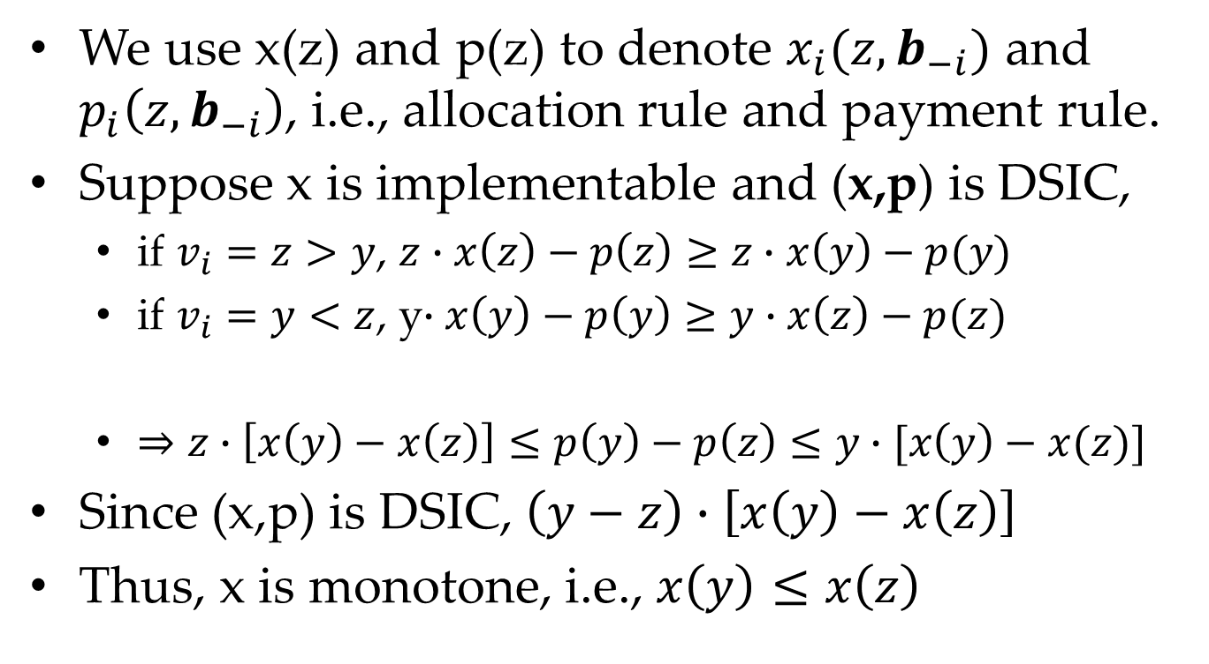
Step 1 of Proof
We use x(z) and p(z) to denote $x_{i}(z,b_{−i})$ and $p_{i}\left(z,b_{−i}\right)$, i.e., allocation rule and payment rule.
Suppose x is implementable and (x,p) is DSIC,
if $v_{i}=z>y$, $z∙x\left(z\right)−p\left(z\right)≥z∙x\left(y\right)−p(y)$
if $v_{i}=y<z$, y$∙x\left(y\right)−p\left(y\right)≥y∙x\left(z\right)−p(z)$
$⇒z∙\left[x\left(y\right)−x\left(z\right)\right]≤p\left(y\right)−p\left(z\right)≤y∙[x\left(y\right)−x(z)]$
Since (x,p) is DSIC, $\left(y−z\right)∙\left[x\left(y\right)−x\left(z\right)\right]$
Thus, x is monotone, i.e., $x\left(y\right)≤x\left(z\right)$

Slide 32
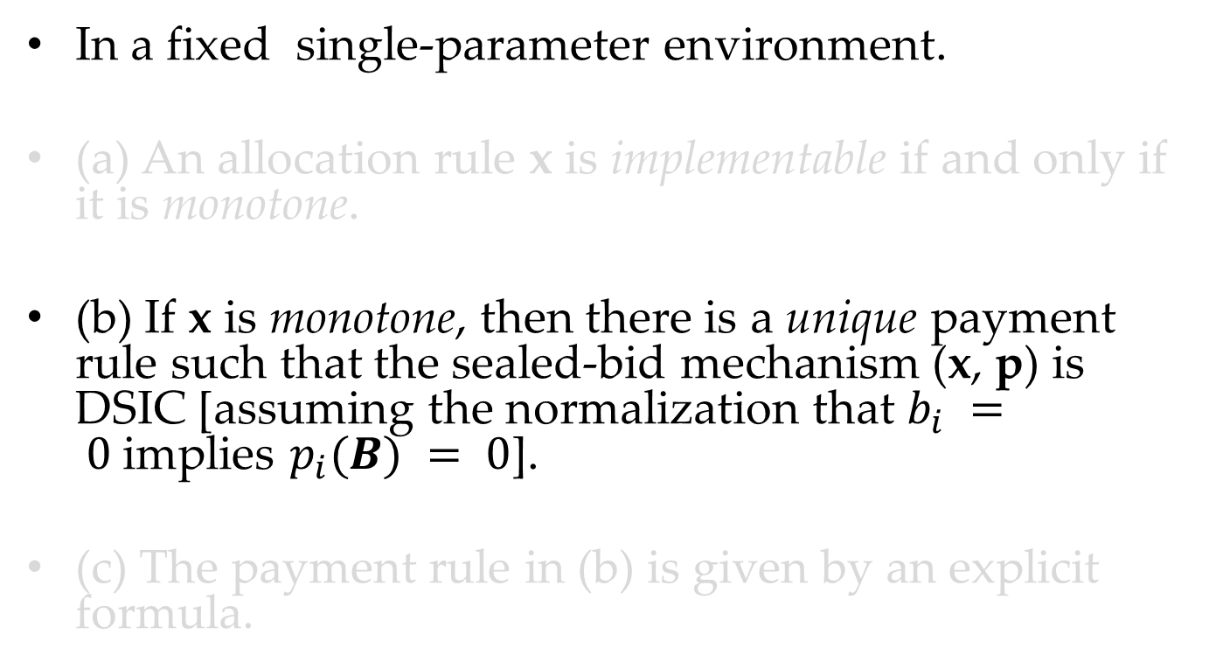
Myerson’s Lemma
In a fixed single-parameter environment.
(a) An allocation rule x is implementable if and only if it is monotone.
(b) If x is monotone, then there is a unique payment rule such that the sealed-bid mechanism (x, p) is DSIC [assuming the normalization that $b_{i} = 0$implies $p_{i}(B) = 0$].
(c) The payment rule in (b) is given by an explicit formula.

Slide 33
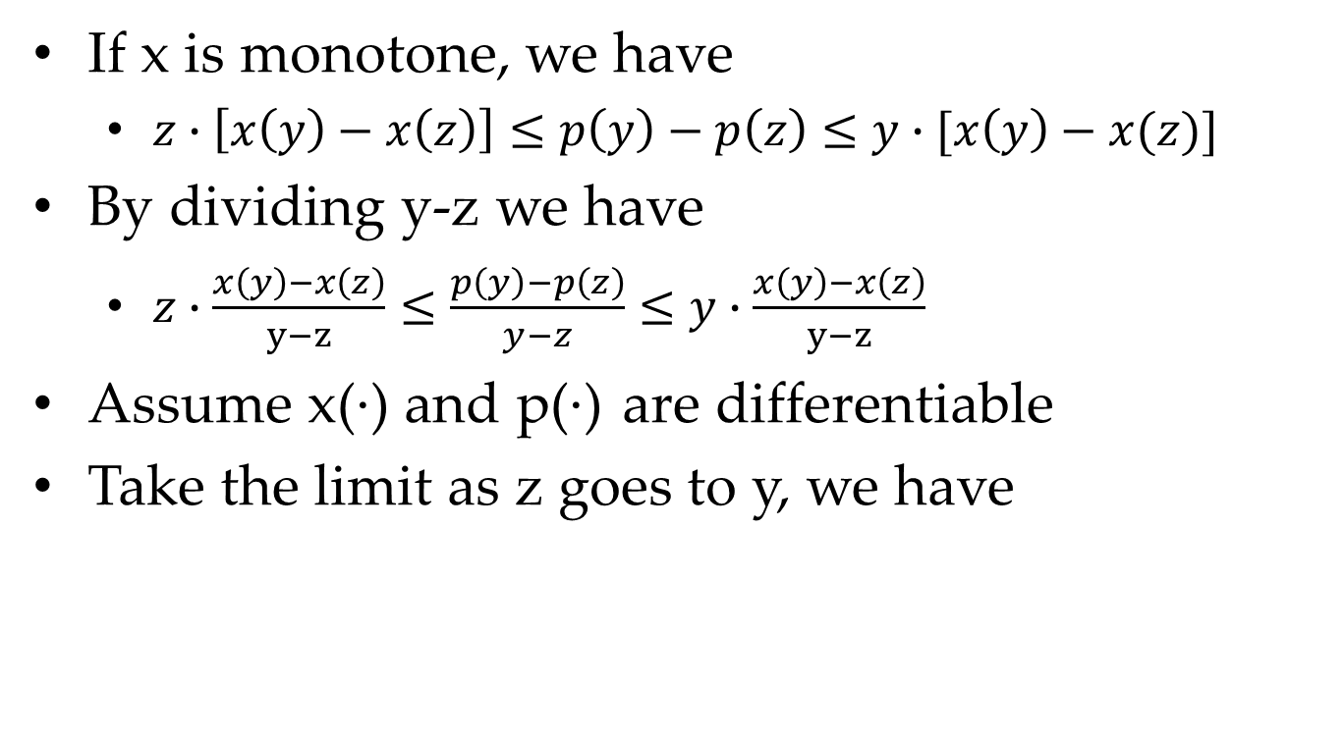
Step 2 of Proof
If x is monotone, we have
$z∙\left[x\left(y\right)−x\left(z\right)\right]≤p\left(y\right)−p\left(z\right)≤y∙[x\left(y\right)−x(z)]$
By dividing y-z we have
$z∙\frac{x\left(y\right)−x\left(z\right)}{y−z}≤\frac{p\left(y\right)−p\left(z\right)}{y−z}≤y∙\frac{x\left(y\right)−x\left(z\right)}{y−z}$
Assume x(·) and p(·) are differentiable
Take the limit as z goes to y, we have

Slide 34
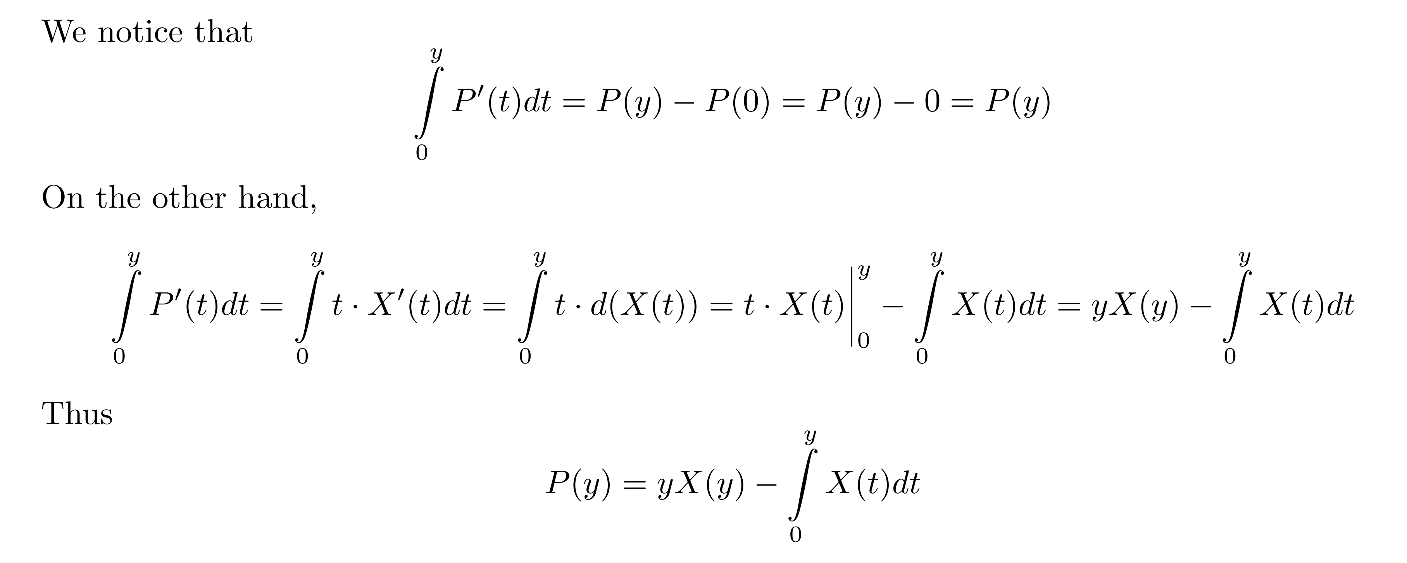
Step 2 of Proof

Slide 35
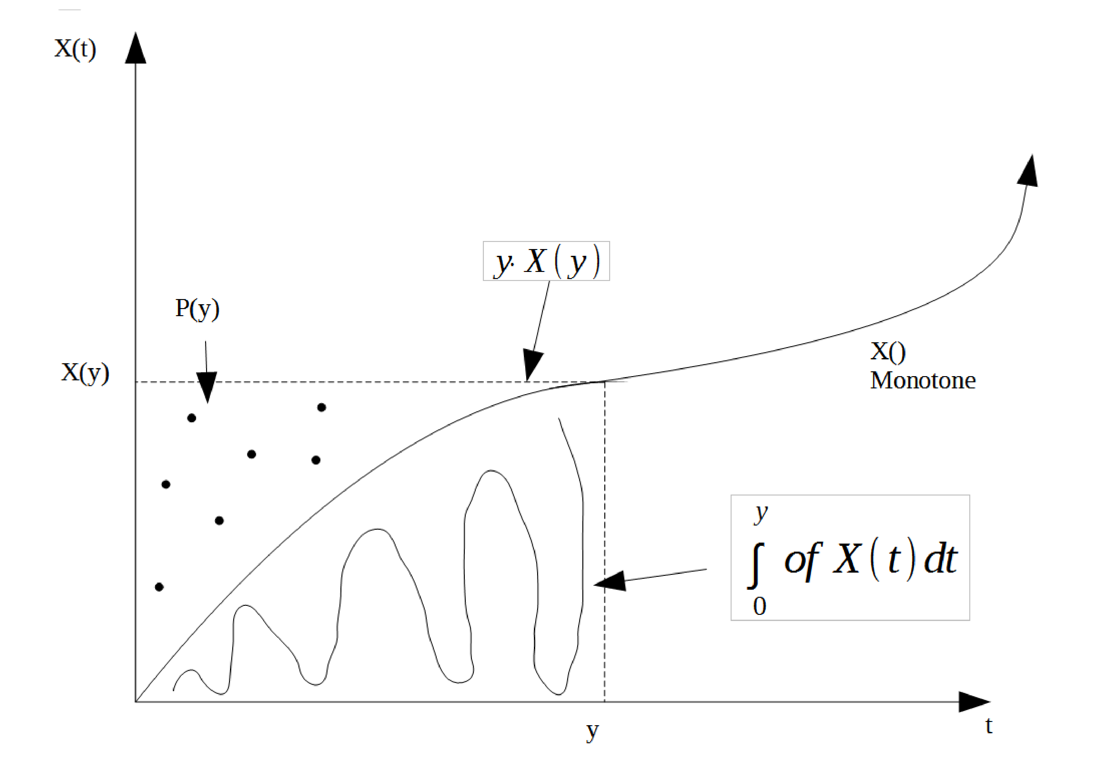
Step 2 of Proof

Slide 36
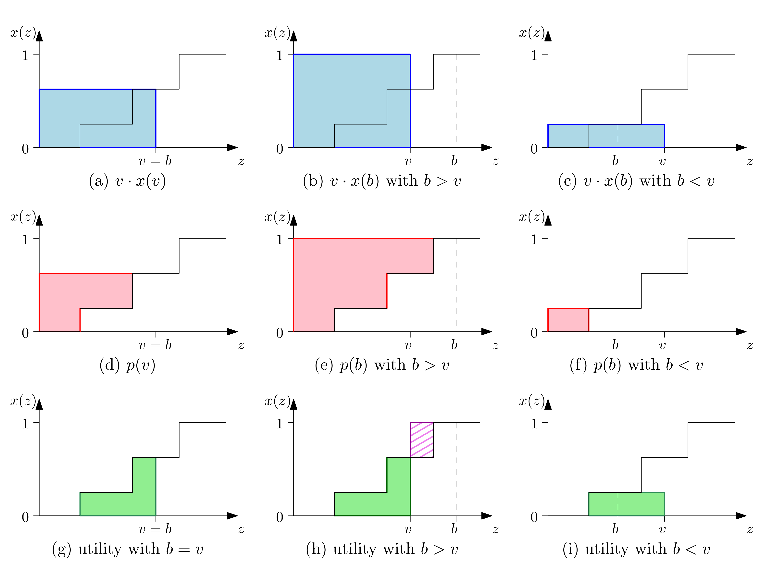
Step 2 of Proof: Piecewise Const.

Slide 37
Step 2 of Proof: Piecewise Const.

Slide 38
Step 2 of Proof: Piecewise Const.

Slide 39
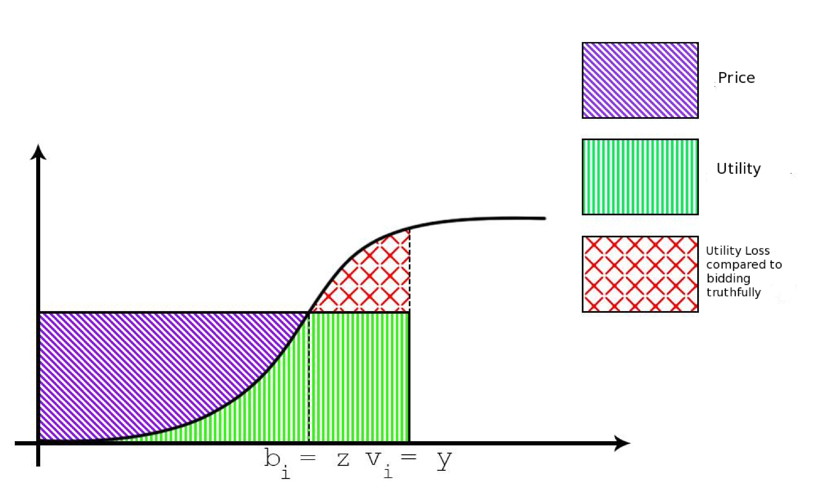
Step 2 of Proof: Underbidding

Slide 40
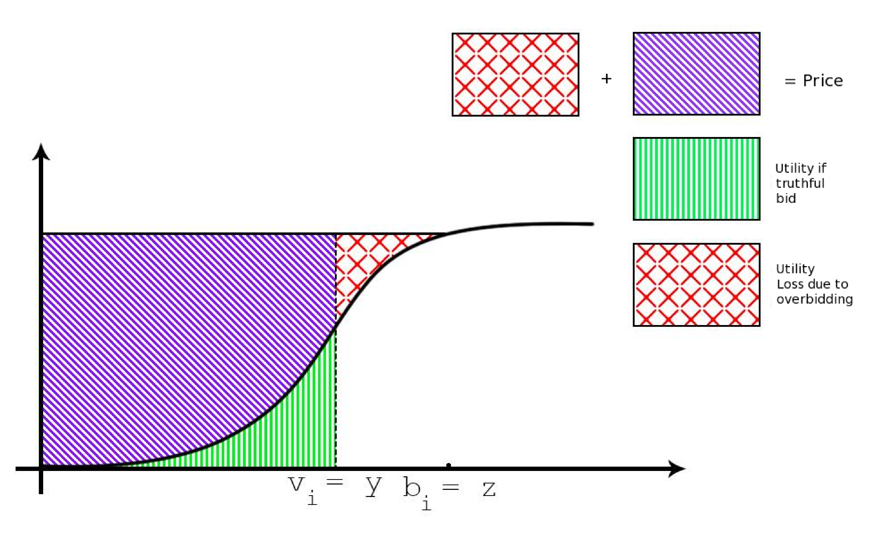
Step 2 of Proof: Overbidding

Slide 41
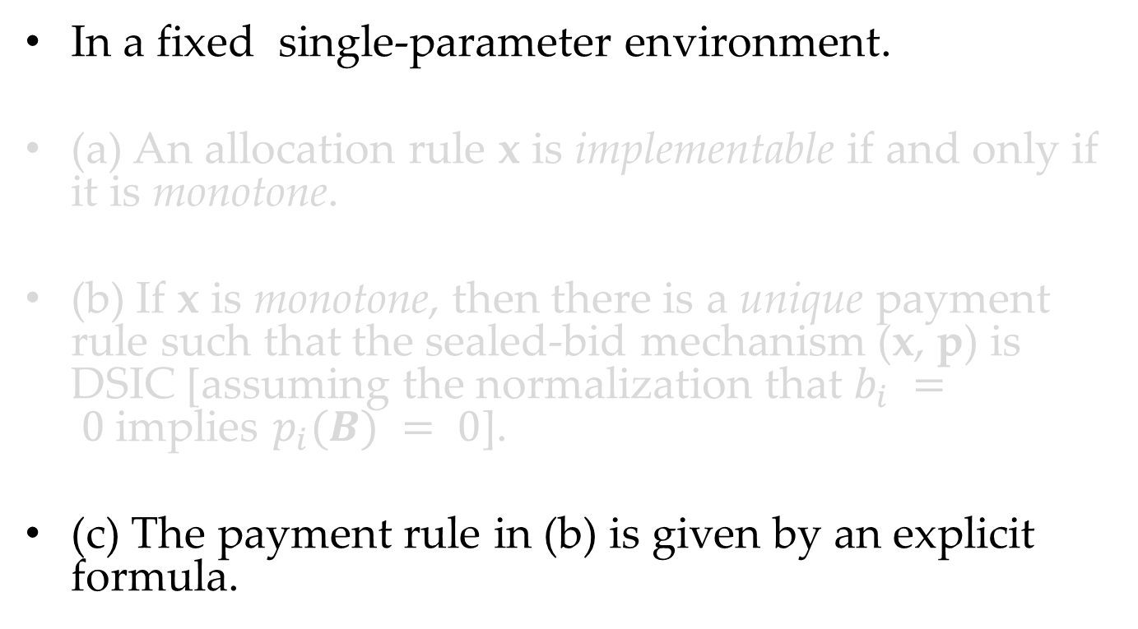
Myerson’s Lemma
In a fixed single-parameter environment.
(a) An allocation rule x is implementable if and only if it is monotone.
(b) If x is monotone, then there is a unique payment rule such that the sealed-bid mechanism (x, p) is DSIC [assuming the normalization that $b_{i} = 0$implies $p_{i}(B) = 0$].
(c) The payment rule in (b) is given by an explicit formula.

Slide 42
Step 3 of Proof

Slide 43
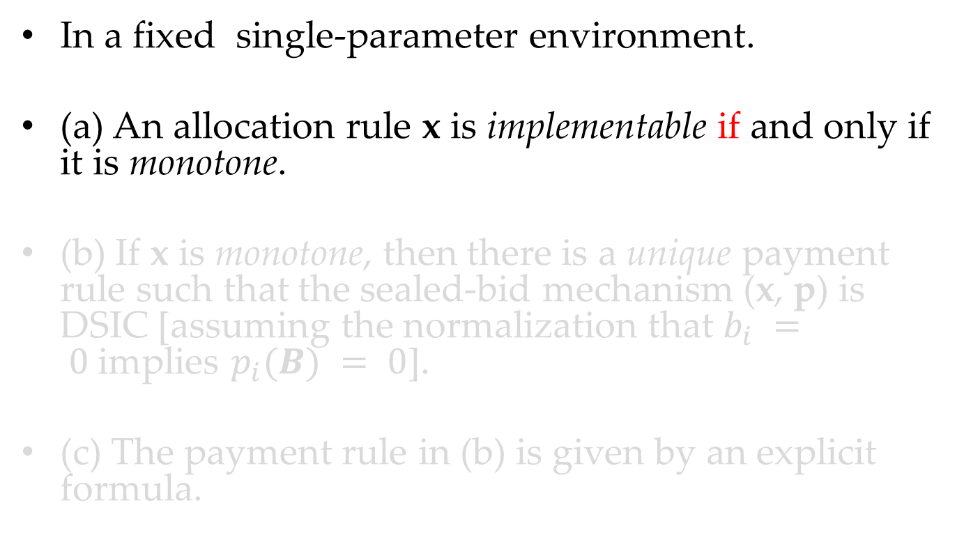
Myerson’s Lemma
In a fixed single-parameter environment.
(a) An allocation rule x is implementable if and only if it is monotone.
(b) If x is monotone, then there is a unique payment rule such that the sealed-bid mechanism (x, p) is DSIC [assuming the normalization that $b_{i} = 0$implies $p_{i}(B) = 0$].
(c) The payment rule in (b) is given by an explicit formula.

Slide 44
Step 4 of Proof “if”

Slide 45
Applying the Myerson’s Lemma:
Single Item Auction

Slide 46
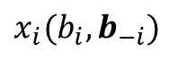
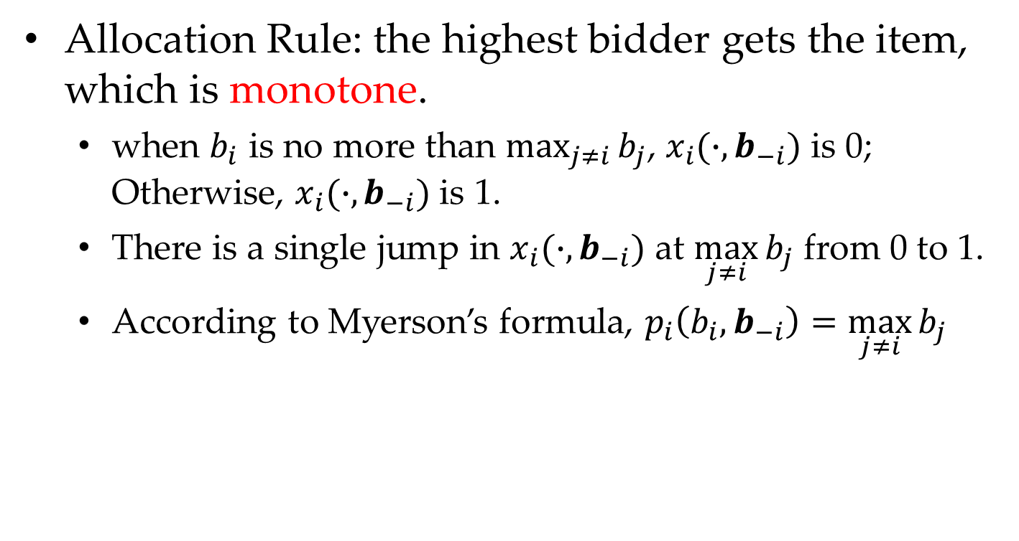
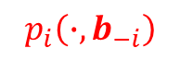
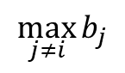

Single Item Auction
Allocation Rule: the highest bidder gets the item, which is monotone.
when $b_{i}$ is no more than $\max_{j≠i}{b_{j}}$, $x_{i}(∙,b_{−i})$ is 0; Otherwise, $x_{i}(∙,b_{−i})$ is 1.
There is a single jump in $x_{i}(∙,b_{−i})$ at $\max_{j≠i}{b_{j}}$ from 0 to 1.
According to Myerson’s formula, $p_{i}\left(b_{i},b_{−i}\right)=\max_{j≠i}{b_{j}}$
$$x_{i}(b_{i},b_{−i})$$
1
$$p_{i}\left(∙,b_{−i}\right)$$
0
$$\max_{j≠i}{b_{j}}$$
$$b_{i}$$

Slide 47
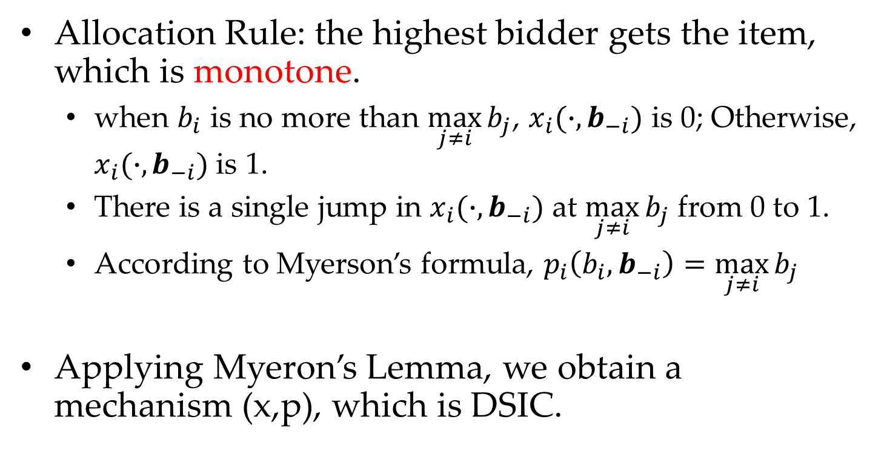
Single Item Auction
Allocation Rule: the highest bidder gets the item, which is monotone.
when $b_{i}$ is no more than $\max_{j≠i}{b_{j}}$, $x_{i}(∙,b_{−i})$ is 0; Otherwise, $x_{i}(∙,b_{−i})$ is 1.
There is a single jump in $x_{i}(∙,b_{−i})$ at $\max_{j≠i}{b_{j}}$ from 0 to 1.
According to Myerson’s formula, $p_{i}\left(b_{i},b_{−i}\right)=\max_{j≠i}{b_{j}}$
Applying Myeron’s Lemma, we obtain a mechanism (x,p), which is DSIC.

Slide 48
Applying the Myerson’s Lemma: Sponsored Search Solved

Slide 49
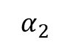
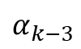
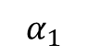
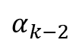
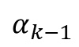
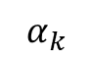
Sponsored Search Auction
Allocation Rule: Greedy, the top-k highest get the k-th slot
CTR
$$α_{1}$$
$$α_{2}$$
$$α_{k−3}$$
$$α_{k−2}$$
$$α_{k−1}$$
$$α_{k}$$
Bid
top-k
top-(k-1)
top-(k-2)
top-(k-3)
top-2
top-1

Slide 50
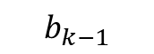
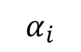

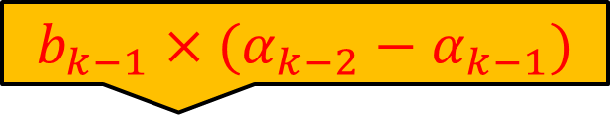
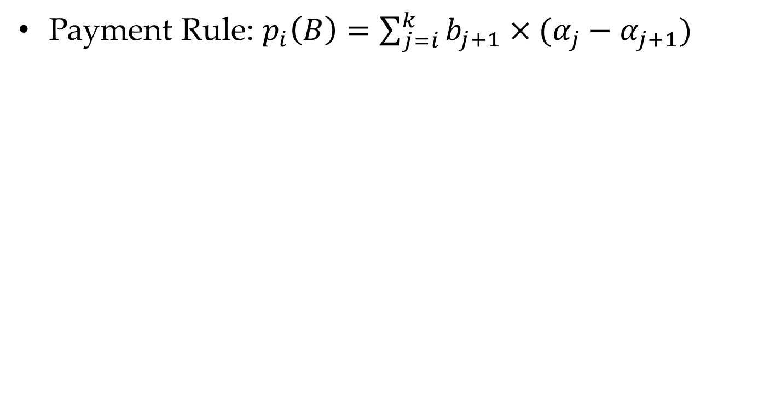




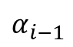
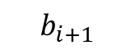
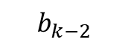
Sponsored Search Auction
Payment Rule: $p_{i}\left(B\right)=\sum_{j=i}^{k}{b_{j+1}×(α_{j}−α_{j+1})}$
CTR
$$b_{i+1}×(α_{i}−α_{i+1})$$
$$α_{i}$$
$$α_{i−1}$$
$$b_{k−2}×(α_{k−3}−α_{k−2})$$
$$α_{k−3}$$
$$b_{k−1}×(α_{k−2}−α_{k−1})$$
$$α_{k−2}$$
$$α_{k−1}$$
$$α_{k}$$
Bid
$$b_{k+1}$$
$$b_{k}$$
$$b_{k−1}$$
$$b_{k−2}$$
$$b_{i+2}$$
$$b_{i+1}$$

Slide 51
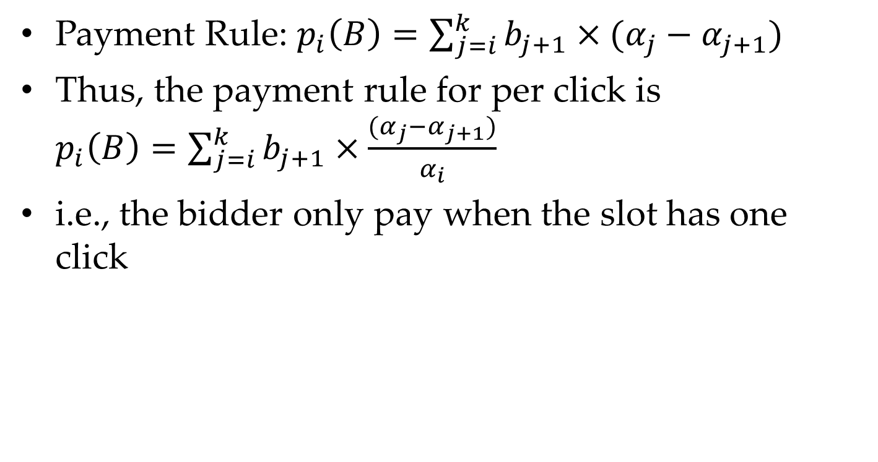
Sponsored Search Auction
Payment Rule: $p_{i}\left(B\right)=\sum_{j=i}^{k}{b_{j+1}×(α_{j}−α_{j+1})}$
Thus, the payment rule for per click is $p_{i}\left(B\right)=\sum_{j=i}^{k}{b_{j+1}×\frac{(α_{j}−α_{j+1})}{α_{i}}}$
i.e., the bidder only pay when the slot has one click

Slide 52
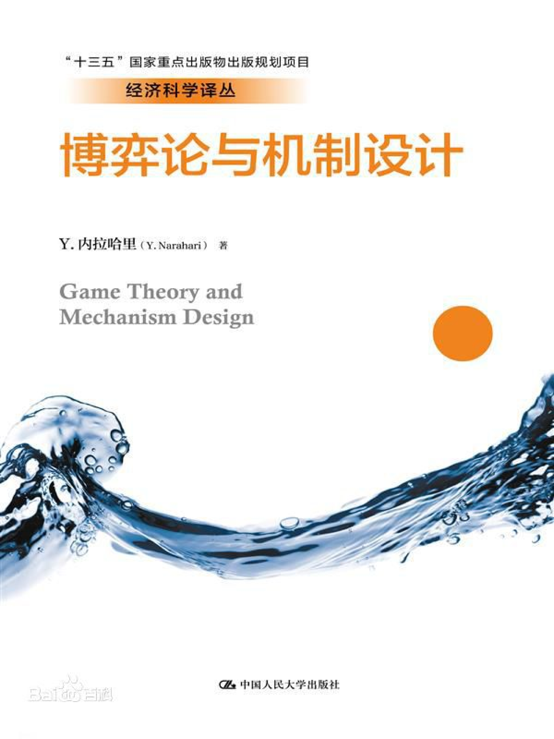
Sponsored Search Auction
I refer to read Chapter 21 and Chapter 22 of the orange book for more details about Myerson Auction and Sponsored Search Auction.

Slide 53
Summary

Slide 54
Summary
General Setting of Mechanism Design Environment
Single-Parameter Environment
Myerson’s Statements
Myerson’s Lemma
Sponsored Search Auction

Slide 55
Thanks
Any Questions ???
Notes:
why called single parameter? Private valuation for only one item.
the difference of direct mechanism and indirect mechanism.
Type \Theta_i 和 preference \theta_i

